Slide 1


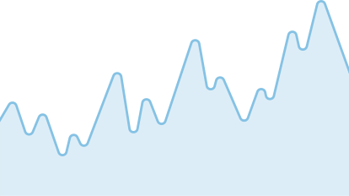
Nashville Software School
Vladyslav Misonh
US Housing
Market Trends
Explore price shifts, economic drivers, and 3-year forecasts.

Slide 2
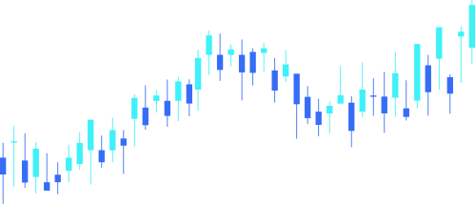
Nashville Software School
US Housing Market Overview
This project explores trends in U.S. home values by analyzing Zillow housing data enriched with public indicators like income, unemployment, taxes, and disasters.
IDENTIFY KEY FACTORS DRIVING HOME PRICES
TRACK HOUSING PRICE CHANGES OVER TIME
FORECAST FUTURE HOME VALUES
Gain a deeper understanding of market shifts from 2018–2023.
Discover how income levels, tax rates, and unemployment correlate with housing trends.
Build predictive models to estimate housing prices through 2026.
US Housing
Market Trends
page 002

Slide 3

Nashville Software School
Why This Project?
Understanding real estate trends is more important than ever in our reality, as rising home prices, economic uncertainty, and post-pandemic shifts reshape the U.S. housing landscape.
With my background in computer mathematics and passion for data analysis, I wanted to explore:
• How major factors like income, unemployment, and tax rates influence home values
• What regions are most vulnerable or resilient to economic changes
• Whether we can forecast housing prices with confidence and clarity
This project not only allowed me to apply my skills in analytics, but also to create a tool that could guide better decisions—for analysts, buyers, or policymakers.
US Housing
Market Trends
page 003

Slide 4

Nashville Software School
1. HOW HAVE HOME PRICES CHANGED IN MAJOR U.S. METRO AREAS FROM 2018 TO 2023?
Questions to Explore
2. WHICH METRO AREAS EXPERIENCED THE FASTEST GROWTH IN HOME VALUES?
3. WHAT EXTERNAL FACTORS—SUCH AS UNEMPLOYMENT, INCOME LEVELS, AND TAX RATES—ARE MOST STRONGLY ASSOCIATED WITH PRICE SHIFTS?
4. CAN WE BUILD RELIABLE 3-YEAR FORECASTS FOR HOME VALUES ACROSS KEY METRO AREAS?
US Housing
Market Trends
page 004

Slide 5

Nashville Software School
Data Sources
HOUSING MARKET DATA (ZILLOW)
Downloaded datasets covering:
ZHVI (Zillow Home Value Index)
Inventory of homes
Sales of single-family residences
ECONOMIC INDICATORS (FRED)
Pulled via API:
Median household income
Unemployment rate
Population estimates
TAX DATA (OPENICPSR)
Downloaded panel dataset with:
State/local sales tax
Income tax rates
Property tax estimates
US Housing
Market Trends
page 005

Slide 6

Nashville Software School
Dataset Overview
Time Frame
The dataset spans from January 2018 to December 2026, including 5-years of historical data and machine-learning-based 3-year forecasts.
Geographic Coverage
50 major U.S. metro areas
United States national average (for baseline comparison)
Granularity
Data is aggregated at a monthly level
Ensures consistency across different sources and indicators
US Housing
Market Trends
page 006

Slide 7

Nashville Software School
1. Trends Overview
Understanding the trajectory of U.S. home values is crucial for homeowners, investors, and policymakers alike.
In this section, we uncover:
The national growth in home prices from 2018 to 2023
Which metro areas have experienced the most significant changes
Regional differences and cyclical market patterns
Visual insights will guide us through how the housing market has evolved—and what signals it may hold for the future.
US Housing
Market Trends
page 007

Slide 8
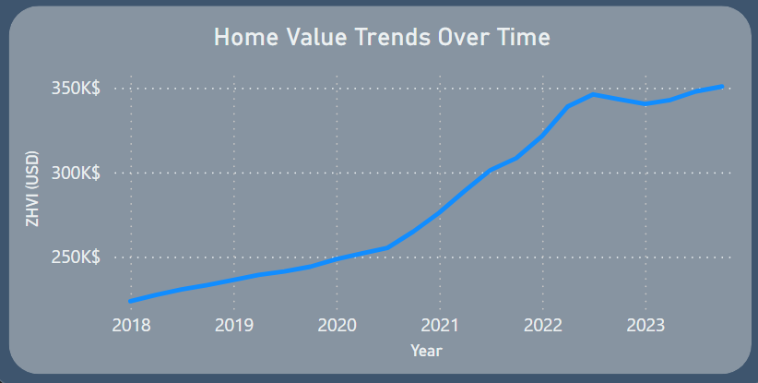
Nashville Software School
U.S. ZHVI Over Time
A sharp COVID-era price spike in 2020–2021 driven by low interest rates, remote work migration, and supply constraints
A moderation in 2022 due to rising interest rates and inflation
A stabilization trend in 2023 as the market began to normalize
US Housing
Market Trends
page 008

Slide 9
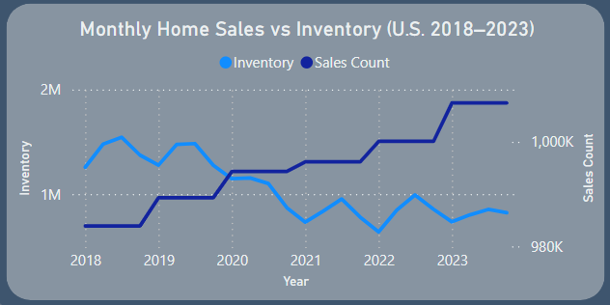
Nashville Software School
Monthly Home Sales & Inventory Trends
Inventory fell sharply during 2020–2021, as high demand outpaced supply — contributing to rapid price appreciation.
Sales volumes peaked in 2021, coinciding with historically low interest rates.
US Housing
Market Trends
page 009

Slide 10
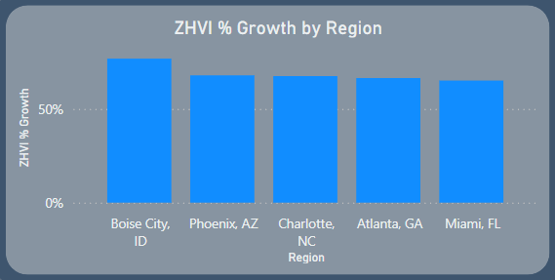
Nashville Software School
Top 5 Fastest-Growing Metros (2018–2023)
Each of these metros saw over 60% growth in home values, indicating robust local housing demand.
Markets like Boise, Phoenix, and Charlotte benefited from population inflows, remote work migration, and comparative affordability during the post-2020 housing boom.
US Housing
Market Trends
page 010

Slide 11

Nashville Software School
2. Drivers of Home Value
This section explores the underlying factors that influence home price trends across different metro areas.
Key drivers include:
Economic indicators like median income and unemployment rates
Tax policies, including local income and sales taxes
Environmental factors such as the frequency of natural disasters
Population shifts, migration trends, and job market dynamics
Understanding these variables provides deeper insight into why home values rise faster in some regions and helps anticipate future housing market performance.
US Housing
Market Trends
page 011

Slide 12
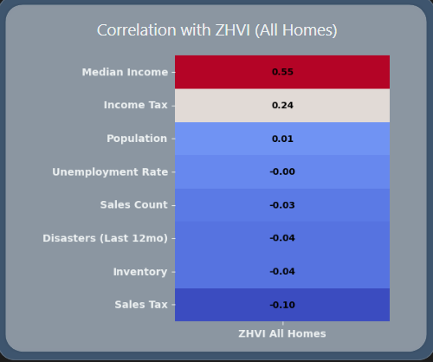
Nashville Software School
Market Drivers of ZHVI
Median Income shows a strong positive correlation with ZHVI, suggesting that higher earning regions tend to have higher home values.
Unemployment Rate and Natural Disasters display a negative relationship with ZHVI, indicating potential downward pressure on housing values in affected areas.
Tax Variables (e.g., Income Tax, Sales Tax) show mixed correlations, reflecting regional policy impacts that may either incentivize or deter housing demand.
US Housing
Market Trends
page 012

Slide 13
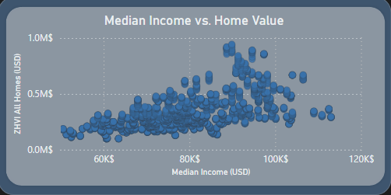
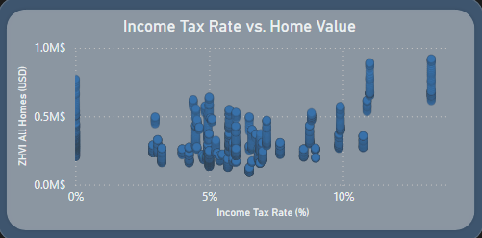
Nashville Software School
ZHVI vs Median Income & Tax
Higher median incomes are strongly associated with higher home values, reflecting greater purchasing power and demand in more affluent regions.
Higher income tax rates also tend to align with elevated ZHVI, possibly due to urbanized states where both taxes and housing costs are above average.
Notably, some low-tax metros still exhibit high home values, driven by factors like inbound migration, housing supply constraints, or regional desirability.
US Housing
Market Trends
page 013

Slide 14

Nashville Software School
3. Regional Comparison
As home values shift in response to local conditions, regional comparisons become essential to understanding the broader housing landscape.
In this section, we explore how metro areas across the U.S. differ in:
Market performance and volatility
Local economic conditions and policy impacts
Affordability, growth, and housing demand
These insights help reveal where housing markets are thriving, stagnating, or shifting—providing essential context for stakeholders, policymakers, and potential investors.
US Housing
Market Trends
page 014

Slide 15
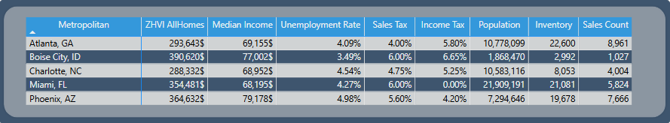
Nashville Software School
Regional Housing Market Summary
This matrix provides a side-by-side comparison of key housing and economic metrics across U.S. metro areas (2018–2023).
These indicators help assess which metros are thriving, which are under pressure, and how different forces—from income to supply—shape housing trends across regions.
By examining the full picture, we gain insights into where markets may offer value, face affordability risks, or require policy intervention.
US Housing
Market Trends
page 015

Slide 16
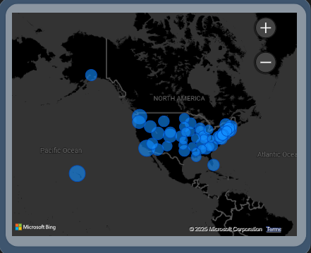
Nashville Software School
ZHVI by Region
West Coast and Northeast metros generally report the highest home values, driven by economic hubs, limited housing supply, and sustained demand.
Southeastern regions show moderate but growing values, reflecting migration patterns and affordability-driven relocation.
Midwestern metros tend to maintain more affordable housing, though some areas experienced notable appreciation during the pandemic era.
US Housing
Market Trends
page 016

Slide 17

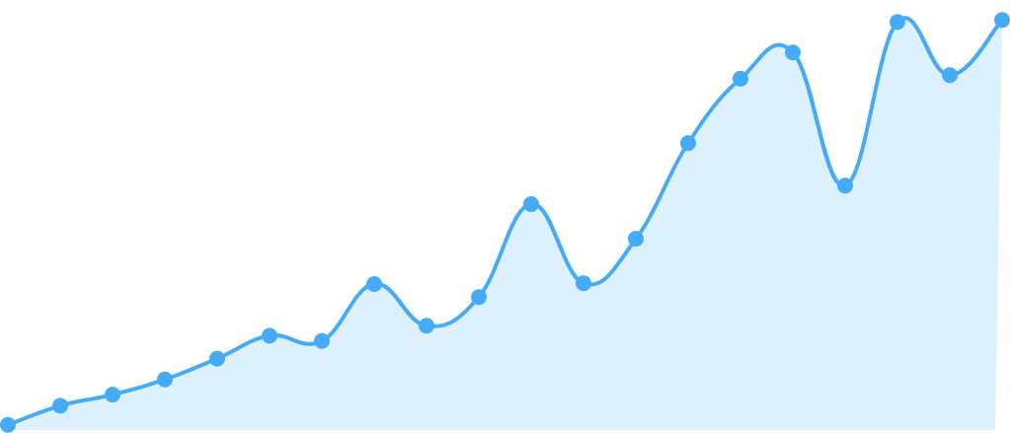
Nashville Software School
4. Taxes & Impact
In this section, we explore how state and local tax policies shape housing markets across U.S. metro areas.
From income taxes that affect household budgets to sales taxes that influence cost of living, taxes play a crucial role in regional affordability and home value trends.
We’ll examine:
How tax rates correlate with home prices
The geographic distribution of tax burdens
Which metros balance economic prosperity and tax pressure
Understanding the tax landscape helps reveal hidden costs and pressures that impact long-term housing market dynamics.
US Housing
Market Trends
page 017

Slide 18
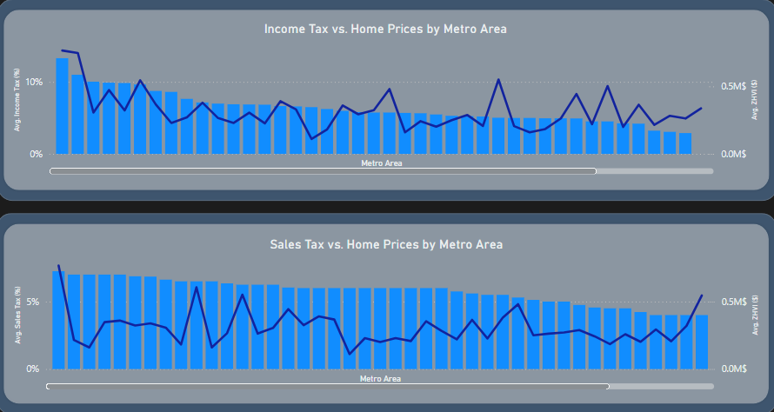
Nashville Software School
Taxes vs. Home Prices
Income Tax appears to have a stronger relationship with home values compared to Sales Tax. Metros with higher income taxes often show elevated home prices, potentially due to urbanization, high demand, and premium housing markets.
Sales Tax demonstrates a weaker or inconsistent pattern, suggesting its impact on home values is less direct or mediated by other regional factors.
Some low-tax metros still exhibit high ZHVI, indicating that housing demand, migration, and supply constraints may outweigh tax effects in certain regions.
US Housing
Market Trends
page 018

Slide 19
Nashville Software School
5. Forecasting
As we look to the future, housing market forecasts offer valuable insights for planning, investment, and policymaking.
In this section, we highlight:
Predicted trends in home values through 2026
Key factors influencing future growth (e.g., income, employment, tax rates)
Emerging opportunities and potential market risks
By combining historical patterns with forward-looking models, these forecasts help stakeholders make informed decisions in a dynamic housing landscape.
US Housing
Market Trends
page 019

Slide 20


Nashville Software School
Forecasting Methodology
TIME SERIES FORECASTING (PROPHET)
PREDICTIVE MODELING (LINEAR REGRESSION)
I used the Prophet model to forecast key economic and policy drivers through 2026:
Median Household Income
Unemployment Rate
Income and Sales Tax Rates
Using the forecasted variables from Step 1, we built a regression model to predict future Zillow Home Value Index (ZHVI) for each metro area.
US Housing
Market Trends
page 020

Slide 21
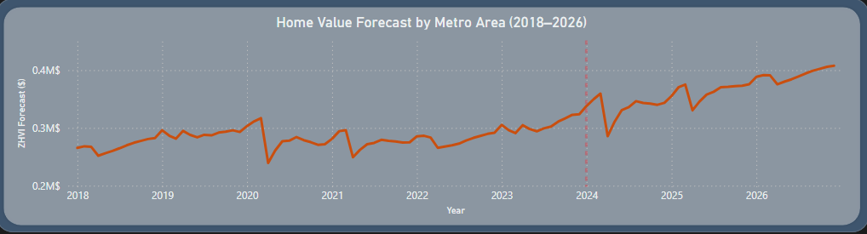
Nashville Software School
Forecast Results
Post-2023 acceleration: National home values show a noticeable rise after 2023, indicating renewed market momentum.
Forecasted growth: By the end of 2026, national ZHVI is projected to exceed $400K, driven by income growth and constrained inventory.
US Housing
Market Trends
page 021

Slide 22
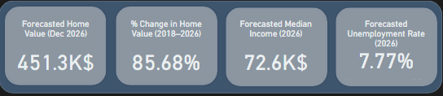
Nashville Software School
Forecasted Outcomes for 2026
As we project forward, several key metrics help us assess the health and direction of the housing market in metro areas by the end of 2026. These indicators provide insights into economic conditions, housing affordability, and potential market risks.
These values reflect machine learning forecasts based on macroeconomic factors, tax policy, and regional growth patterns. They can inform policy, investment strategies, and affordability assessments for stakeholders across the housing ecosystem.
US Housing
Market Trends
page 022

Slide 23
Nashville Software School
6. Key Takeaways & Insights
Understanding the future of the U.S. housing market requires more than just looking at location. Our data-driven analysis reveals deeper forces shaping home values across regions.
FUNDAMENTALS FIRST
POLICY & RISK MATTER
UNEVEN RECOVERY
STRATEGIC IMPLICATIONS
Drivers like income, unemployment, and tax rates outweigh geographic location in shaping future home values.
Forecasts show a steady overall increase in home values, but recovery rates vary widely across metros.
Investors and policymakers should assess economic indicators, not just past performance, to make informed decisions.
High income taxes and economic volatility can suppress growth, even in desirable areas.
US Housing
Market Trends
page 023

Slide 24


Nashville Software School
US Housing
Market Trends
Thank
You!
Thank you for exploring the US housing market forecast with me.
I hope these insights into home value trends, economic factors, and regional drivers help inform your real estate decisions and investment strategies.

